Slide 1
DEPARTMENT OF PHYSICS
SRM INSTITUTE OF SCIENCE AND TECHNOLOGY
18PYB103J –Semiconductor Physics
Lecture 7
E-K DIAGRAM
&
DIRECT AND INDIRECT BANDGAP SEMICONDUCTORS
18PYB103J Module-I Lecture 7

Slide 2

E-K Diagram
E-K Diagram
The conventional band diagram shows the band gap energy only
To know more electrical and optical properties of semiconductor material we need to know E-K diagram
An E-K diagram shows characteristics of particular semiconductor material
It shows the relationship between energy and momentum of available states for electron in the crystal
K being the momentum and E as the energy from a mathematical point of view K is the wave vector
The E-K diagram of semiconductor is obtained by solving the Schrodinger’s equation.
C.B
E_{g}
V.B
18PYB103J Module-I Lecture 7

Slide 3
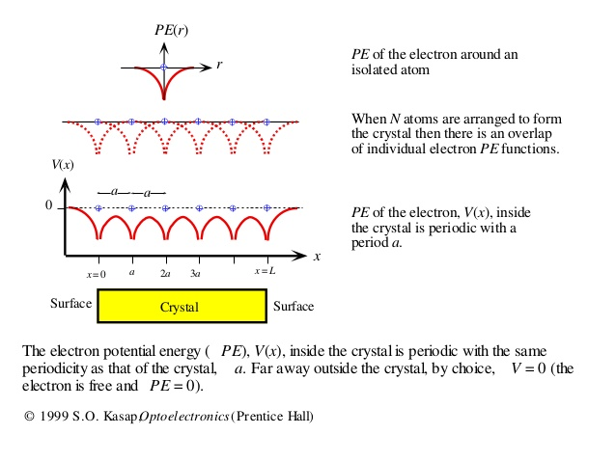
Bloch Theorem
Most of the semiconductors are in crystalline form, i.e the atoms are arranged in periodic manner.
The motion of electron in a crystal is governed by the laws of quantum mechanics.
If we have one electron and one proton system like hydrogen atom it is easy to solve Schrodinger equation.
But in solid there are large number of atoms and electrons present, so its very difficult to solve the Schrodinger equation.
If we consider a one dimensional periodic lattice and the potential energy (PE) of a moving electron depends on its position inside the lattice, but the PE is said to be periodic in nature by F. Bloch, and the probability of finding a electron is also periodic, the wave-function associated with electron is also periodic in nature.
Since the probability of finding electron is equal to |Ψ|²
18PYB103J Module-I Lecture 7

Slide 4
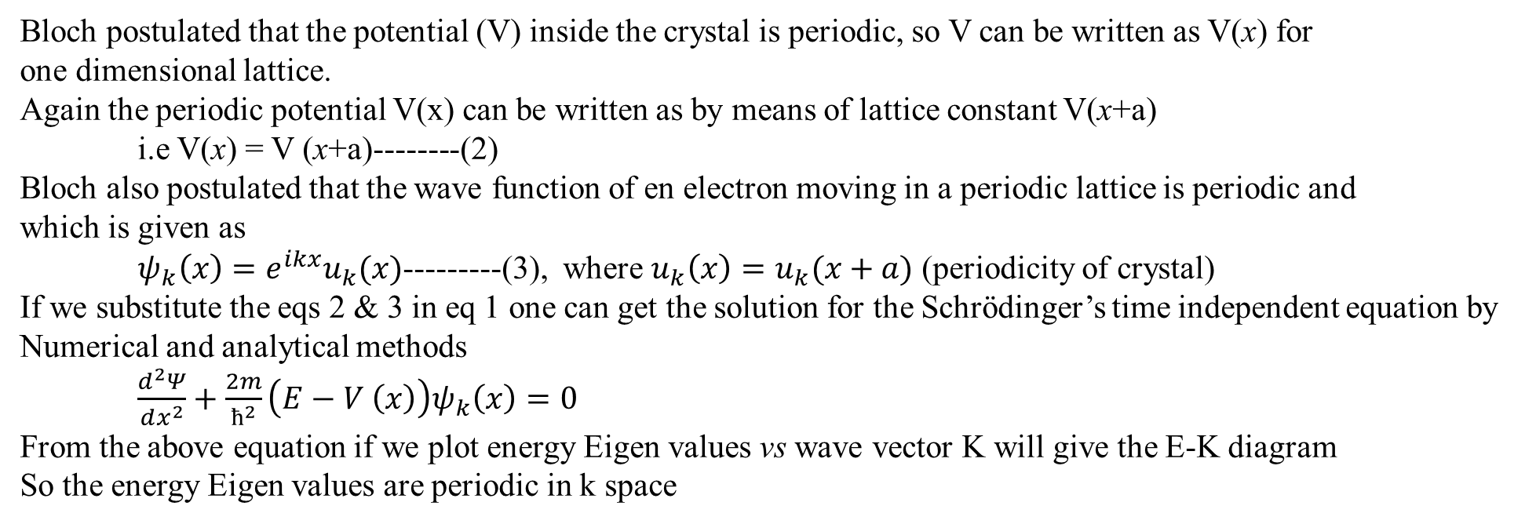
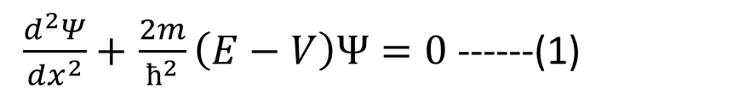
Schrödinger’s one-Dimensional time independent wave equation
$\frac{d^{2}Ψ}{dx^{2}}+$$\frac{2m}{ћ^{2}}\left(E−V\right)Ψ=0$ ------(1)
Bloch postulated that the potential (V) inside the crystal is periodic, so V can be written as V(x) for
one dimensional lattice.
Again the periodic potential V(x) can be written as by means of lattice constant V(x+a)
i.e V(x) = V (x+a)--------(2)
Bloch also postulated that the wave function of en electron moving in a periodic lattice is periodic and
which is given as
$ψ_{k}\left(x\right)=e^{ikx}u_{k}(x)$---------(3), where $u_{k}\left(x\right)=u_{k}(x+a)$ (periodicity of crystal)
If we substitute the eqs 2 & 3 in eq 1 one can get the solution for the Schrödinger’s time independent equation by
Numerical and analytical methods
$\frac{d^{2}Ψ}{dx^{2}}+$$\frac{2m}{ћ^{2}}\left(E−V \left(x\right)\right)ψ_{k}\left(x\right)=0$
From the above equation if we plot energy Eigen values vs wave vector K will give the E-K diagram
So the energy Eigen values are periodic in k space
18PYB103J Module-I Lecture 7

Slide 5
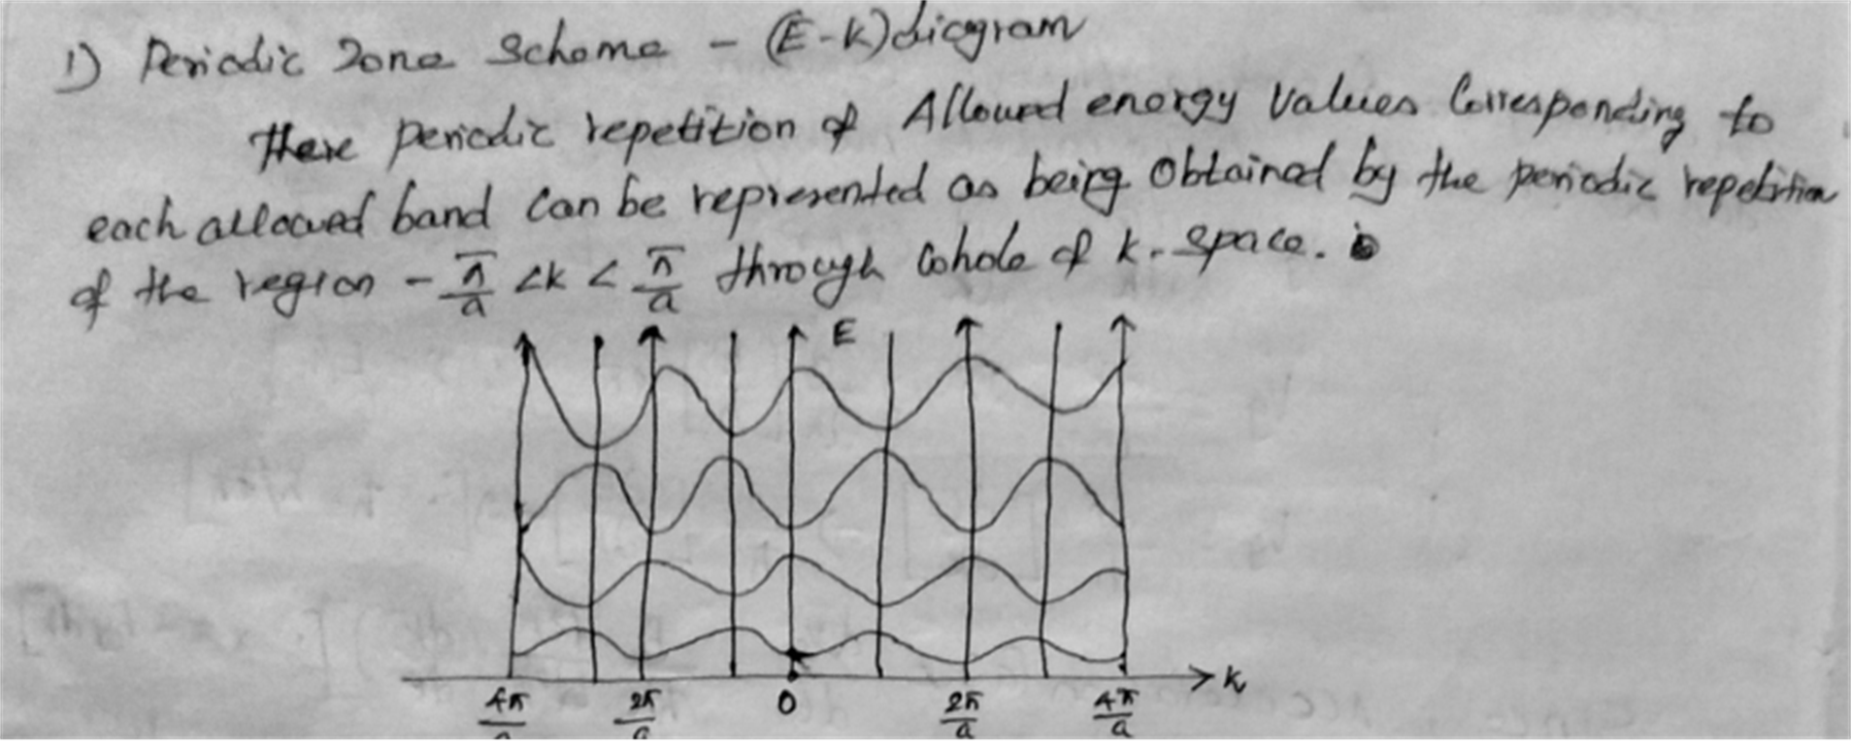
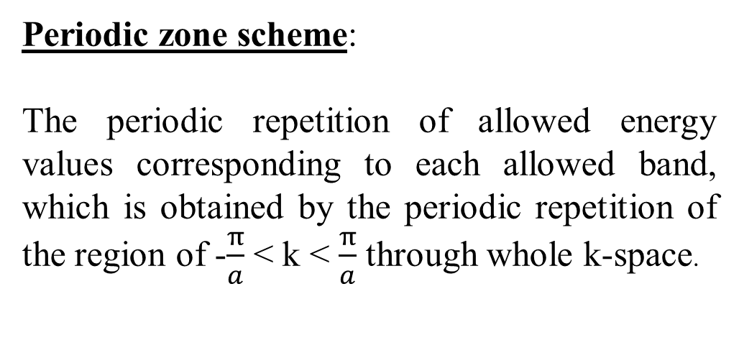
There are three types of E-K diagram
Periodic zone
Extended zone
Reduced zone
Periodic zone scheme:
The periodic repetition of allowed energy values corresponding to each allowed band, which is obtained by the periodic repetition of the region of -$\frac{π}{a}$< k <$\frac{π}{a}$ through whole k-space.
18PYB103J Module-I Lecture 7

Slide 6
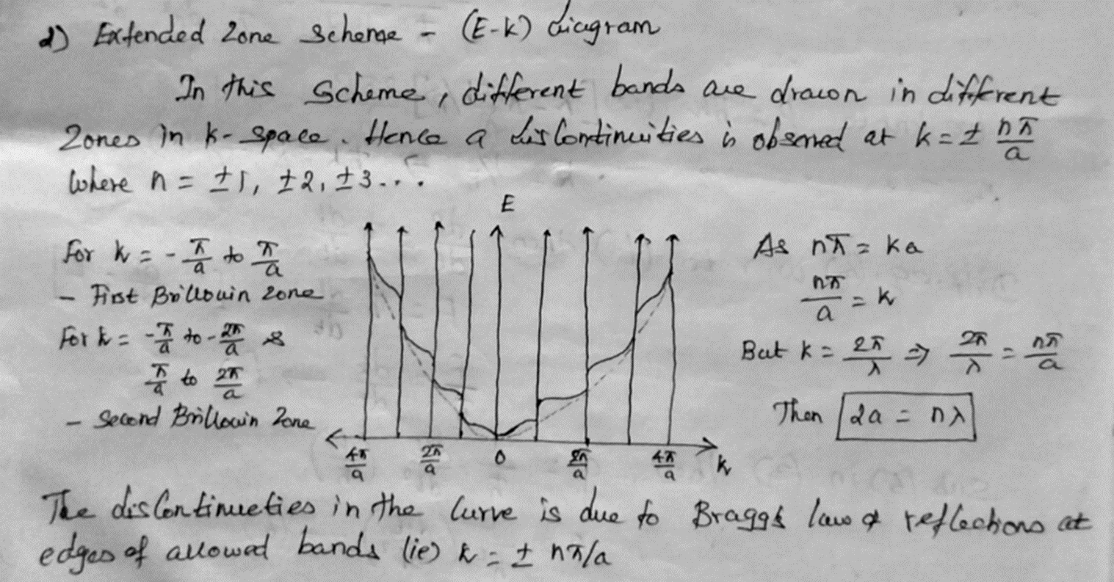
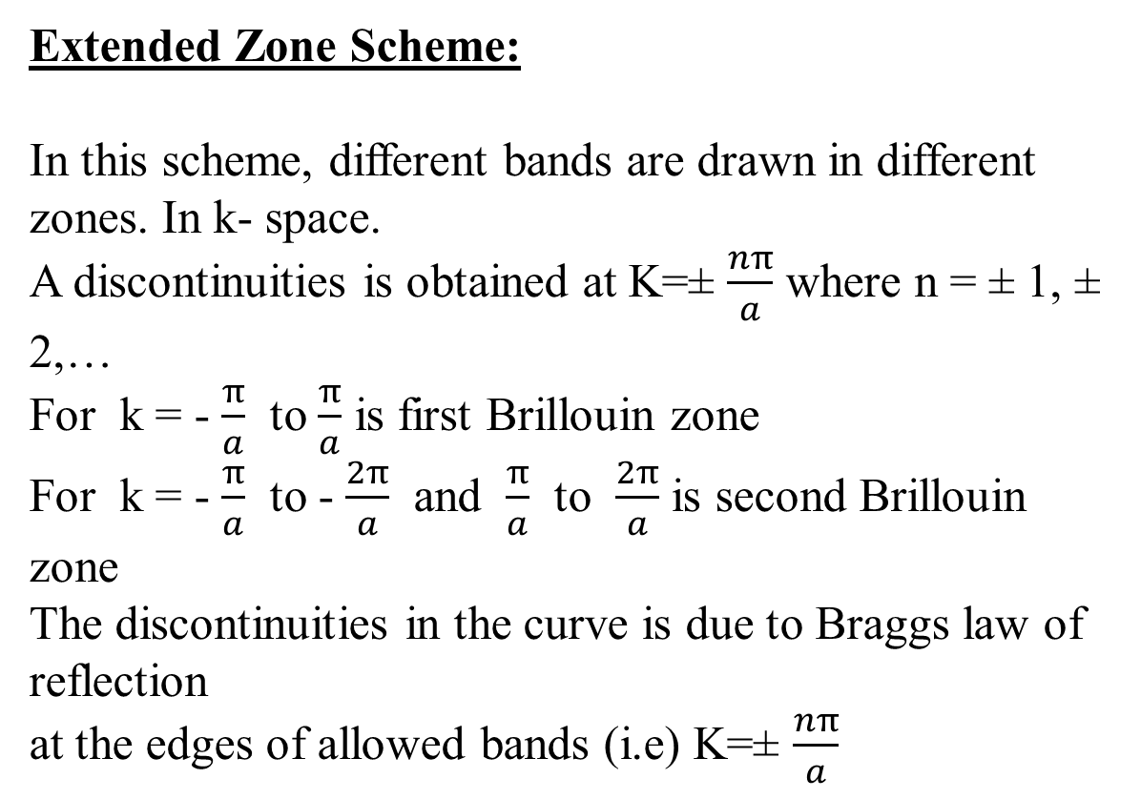
Extended Zone Scheme:
In this scheme, different bands are drawn in different zones. In k- space.
A discontinuities is obtained at K=± $\frac{nπ}{a}$ where n = ± 1, ± 2,…
For k = - $\frac{π}{a}$to $\frac{π}{a}$ is first Brillouin zone
For k = - $\frac{π}{a}$to - $\frac{2π}{a}$ and $\frac{π}{a}$to $\frac{2π}{a}$ is second Brillouin zone
The discontinuities in the curve is due to Braggs law of reflection
at the edges of allowed bands (i.e) K=± $\frac{nπ}{a}$
18PYB103J Module-I Lecture 7

Slide 7
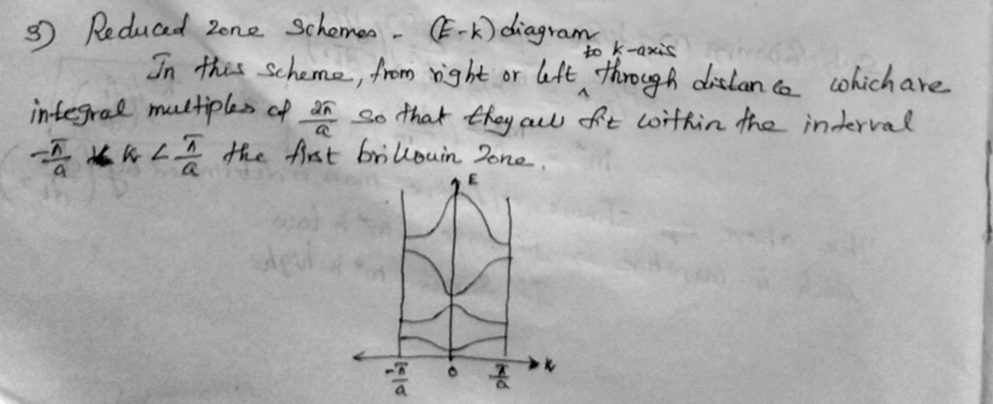
Reduced zone scheme :
In this scheme the first Brillouin zone is shown
since the E-K diagram is periodic, it is sufficient to
restrict to first zone in the reduced scheme.
If we know the energy values of first zone
with respect to K then we know every where because
energy Eigen values are periodic
In many of optoelectronic text books the reduce zone
scheme is shown
18PYB103J Module-I Lecture 7

Slide 8
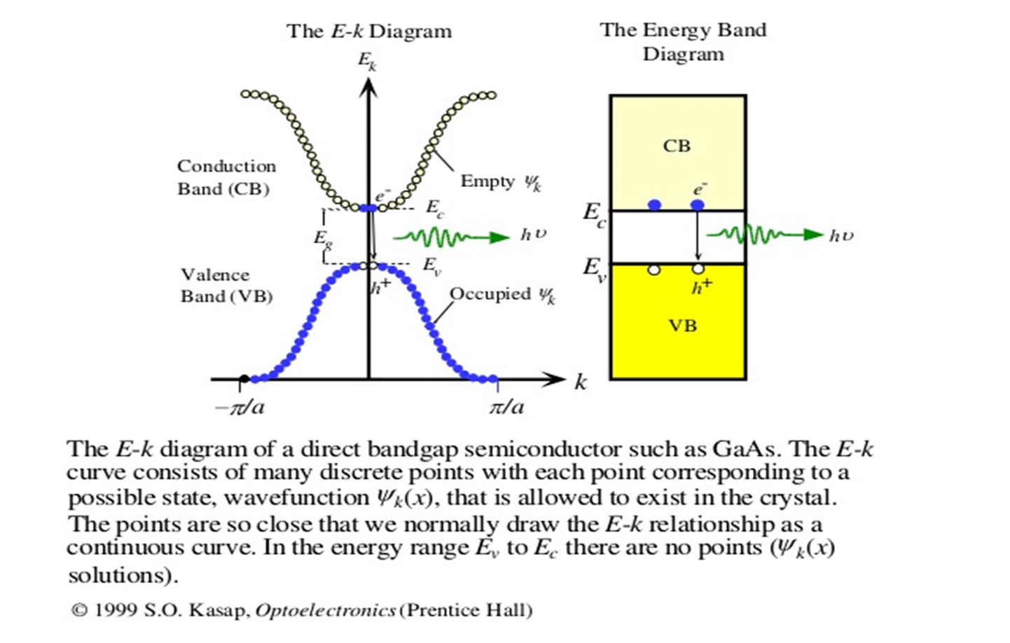
18PYB103J Module-I Lecture 7

Slide 9
18PYB103J Module-I Lecture 7

Slide 10
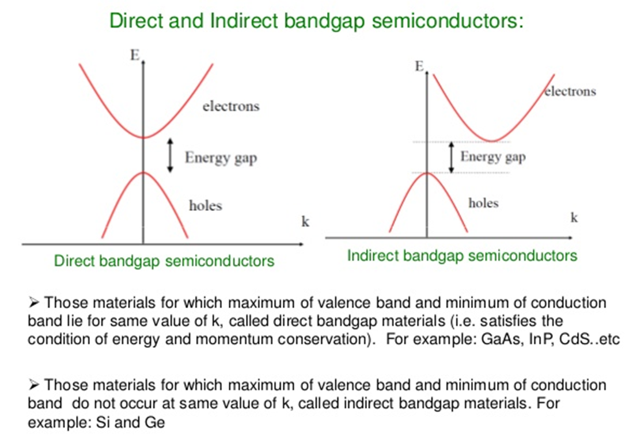
Direct and Indirect band gap semiconductors
We know the relation between energy and wave number for an one dimensional lattice. In real crystals the E – k relationship is much more complicated.
In crystals the interatomic distances and internal potential energy distribution vary with direction of the crystal.
Hence the E – K relationship and energy band formation depends on the orientation of the electron wave vector to the crystallographic axes.
In few crystals like GaAs, the maximum of the valence band occurs at the same value of K as the minimum of the conduction band.
This is called direct band gap semiconductor.
18PYB103J Module-I Lecture 7

Slide 11
Direct and Indirect band gap semiconductors
In few semiconductors like Si the maximum of the valence band does not always occur at the same K values the minimum of the conduction band. This we call indirect band gap semiconductor.
In direct band gap semiconductors the direction of motion of an electron during a transition across the energy gap, remains unchanged.
Hence the efficiency of transition of charge carriers across the band gap is more in direct band gap than in indirect band gap semiconductors.

Slide 12
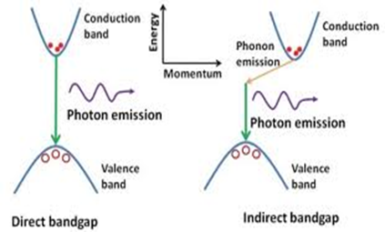
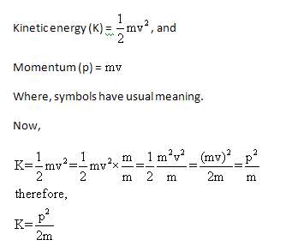
We know
P=ℏk
A direct recombination occurs with the release of energy equals to energy difference between two levels such as E_{g} .
The probability of radiative recombination is high and hence direct bandgap semiconductors are used in optical sources
In indirect band gap, Due to relative difference in momentum , first the momentum is conserved by release of
energy only after both the
Momentum align themselves. The probability of radiative recombination is comparatively low.
18PYB103J Module-I Lecture 7

Slide 13
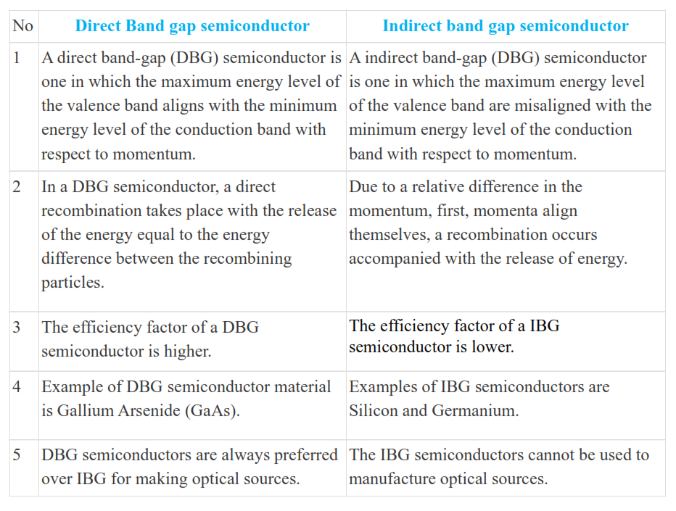
18PYB103J Module-I Lecture 7

Slide 14
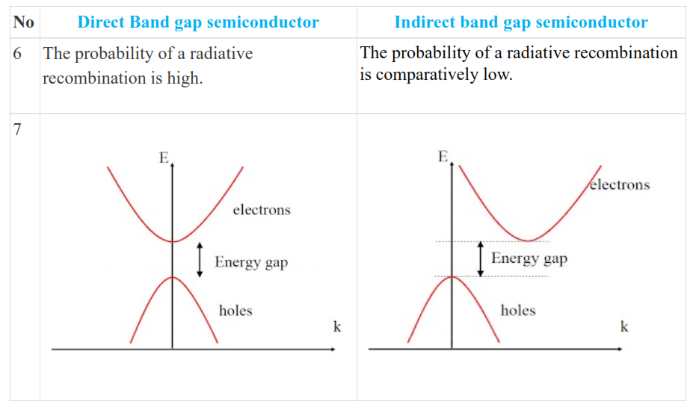
18PYB103J Module-I Lecture 7

